Slide 1
Base R

Slide 2
Introduction
R is another data science language more specifically geared towards statistics. R is an implementation of the S language by John Chambers written originally by Ross Ihaka and Robert Gentleman. The R Core Team, R Foundation and almost countless contributors continually improve and maintain R.
In this course, we're going to cover very little basic R and focus mainly on the so-called tidyverse. However, a little base R goes a long way. You can install R into jupyter notebooks and then have it as an option. Alternatively, Rstudio is a well known R ide as is ESS in Emacs.

Slide 3
R installation
You can install R from conda environment or directly from CRAN. If on Windows, make sure to install Rtools as well. On a mac, I always made sure that I had the developer tools installed. On linux it's a good idea to have all of the dev version of R system dependencies installed

Slide 4
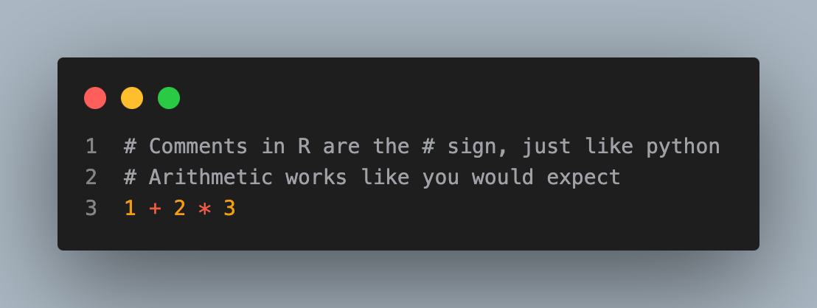
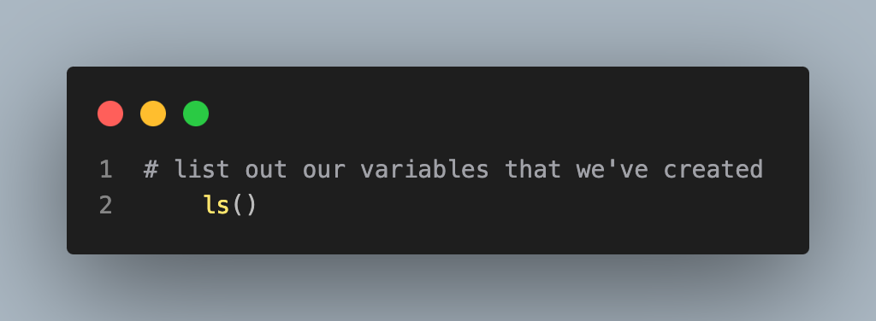
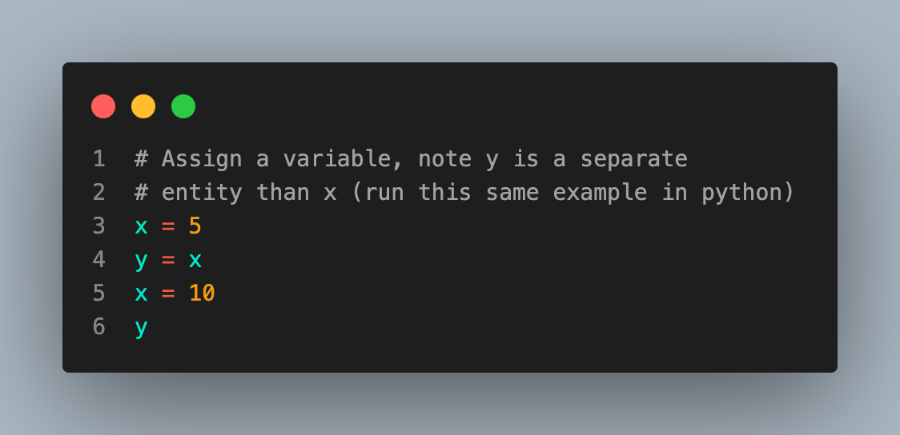
Examples

Slide 5
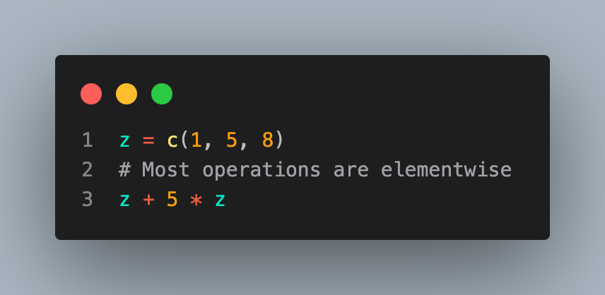
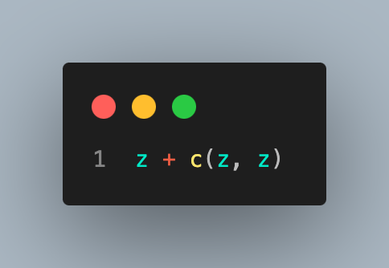
c function
Honestly, the c function in R is perhaps one of the most important. It concatenates things.
[1] 6 30 48
But you have to be careful that R will guess what you want to do. In this case adding a vector of length 3 + a vector of length 6 just repeats the vector of length 3 twice.
[1] 2 10 16 2 10 16

Slide 6
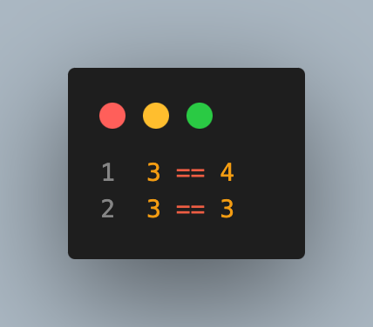
Booleans
R's Boolean values are TRUE and FALSE.
[1] FALSE
[1] TRUE

Slide 7
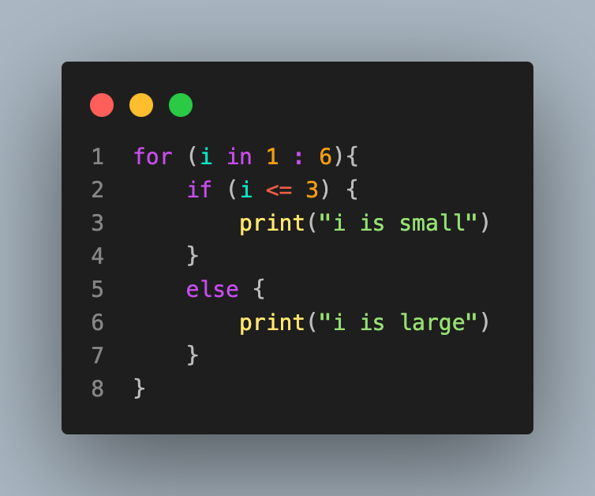
Control flow
R has for loops, while loops and control flow. The syntax a : b creates a vector starting at a and ending at b. Note R uses functional notation, so indentation doesn't mean anything and you have to put curly braces for things included in the for, if or while statements.
[1] "i is small"
[1] "i is small"
[1] "i is small"
[1] "i is large"
[1] "i is large"
[1] "i is large"

Slide 8
Data structures
R's generic structure is a list, which can be made with the command list, its generic matrix structure is a matrix, which can be made with the command matrix and its generic data frame structure is a data frame, which can be made with the command data.frame.

Slide 9
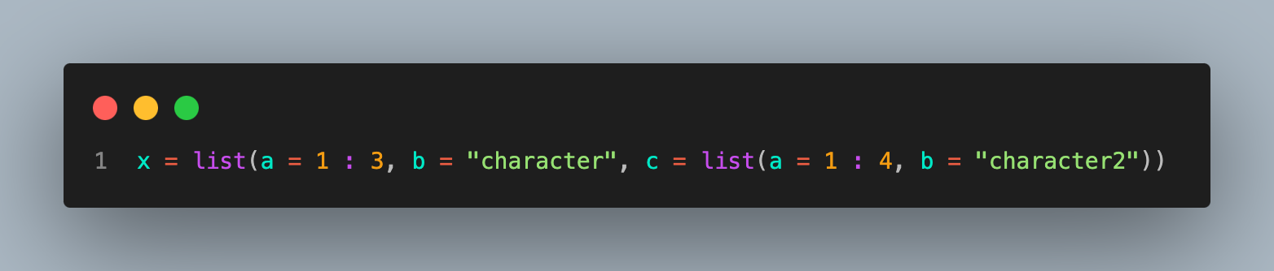
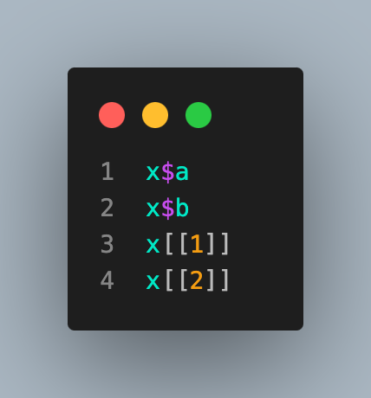
List
Now, x is a list containing three elements, a is a vector, b is a string and c is itself another list. You can reference elements of x with the $ or brackets
[1] 1 2 3
[1] "character"
[1] 1 2 3
[1] "character"

Slide 10
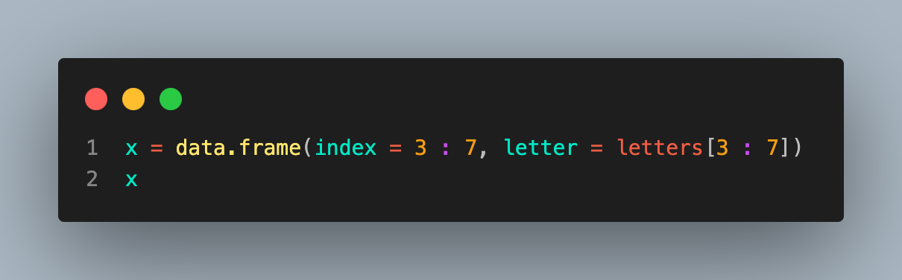
Data frame
Brief technicality, x[1] returns a list containing the first element of x whereas x[[1]] returns the entity itself. Let's create a dataframe. Also note R starts counting at 1 (unlike 0 for python).
index letter
1 3 c
2 4 d
3 5 e
4 6 f
5 7 g

Slide 11
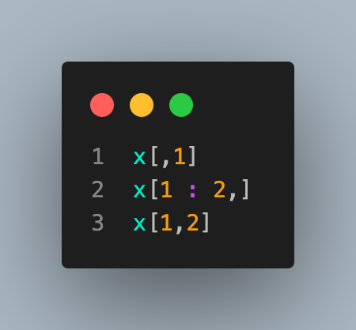
$ operator
The $ operator works on dataframes. In addition, bracket notation works as well.
[1] 3 4 5 6 7
index letter
1 3 c
2 4 d
[1] "c"

Slide 12
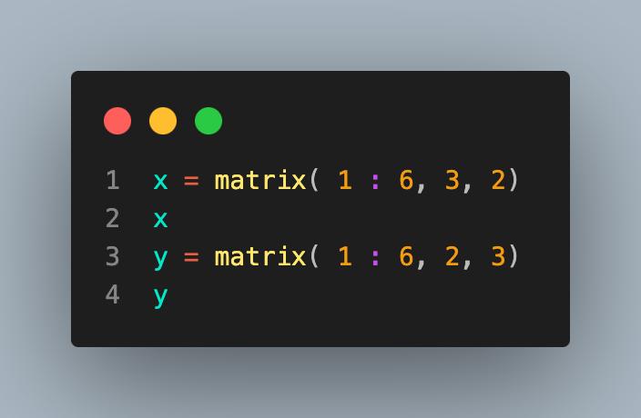
Matrices
[,1] [,2]
[1,] 1 4
[2,] 2 5
[3,] 3 6
[,1] [,2] [,3]
[1,] 1 3 5
[2,] 2 4 6

Slide 13
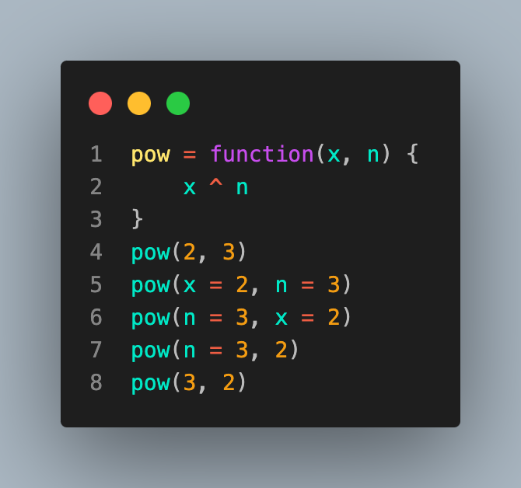
Functions
R has functions and uses so-called lexical scoping. Arguments can be named or not in function calls. But, just like in python, don't get too cute with this.
[1] 8
[1] 8
[1] 8
[1] 8
[1] 9

Slide 14
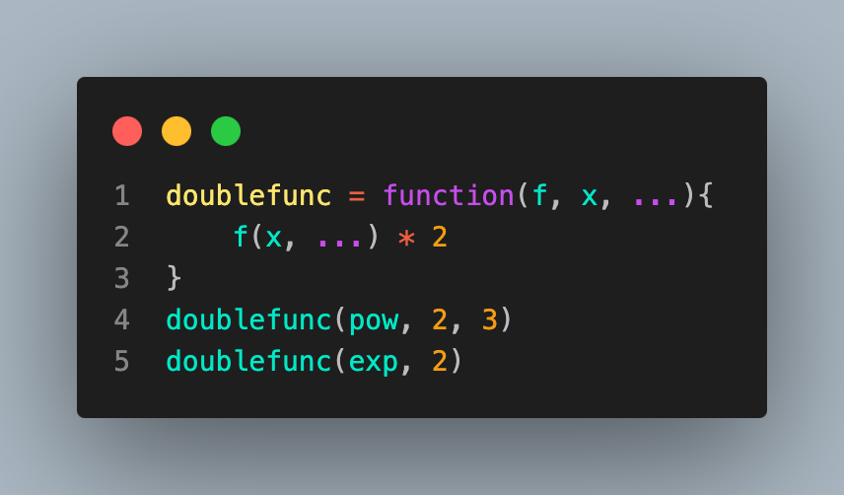
... argument
Functions can be arguments to functions. The ... argument is for variable arguments.
[1] 16
[1] 14.77811

Slide 15
Notice
Variables are defined within the scope of the environment that they are defined in.
Note below, the variable c1 isn't found since it's only defined within f's environment.
Similarly, e is not found within f since it's only found within the function g defined within f.
Finally, note since c is a predefined function I had to define c as c1.
R will let you define c no problem, but it creates confusion. Double check whether a variable is already assigned before defining it to avoid confusion

Slide 16
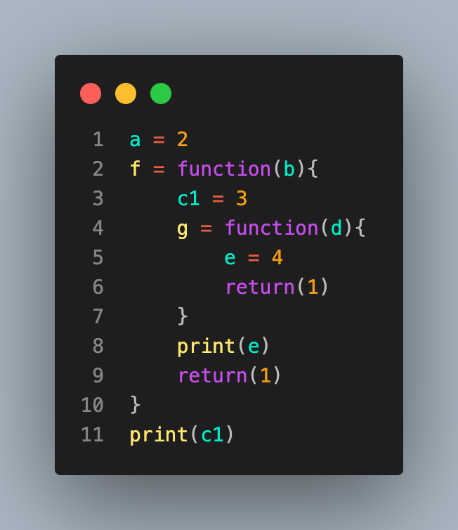
Error in h(simpleError(msg, call)) :
error in evaluating the argument 'x' in selecting a method for function 'print': object 'c1' not found

Slide 17
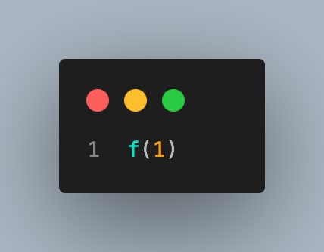
Error in h(simpleError(msg, call)) :
error in evaluating the argument 'x' in selecting a method for function 'print': object 'e' not found
Called from: h(simpleError(msg, call))
Error during wrapup: unimplemented type (29) in 'eval'
Error: no more error handlers available (recursive errors?); invoking 'abort' restart
Error during wrapup: INTEGER() can only be applied to a 'integer', not a 'unknown type #29'
Error: no more error handlers available (recursive errors?); invoking 'abort' restart

